Slide 1
UNHCR Global Trends Forced Displacement: Syria
Sundus Seif

Slide 2
Data
Data collected from UNHCR (The United Nations High Commission for Refugees)
Dataset included observations of the Global Displacement Trends for over 200 countries from 1951 – 2018
Types of forcibly displaced persons:
Refugee
Asylum Seeker
Internally Displaced Person (IDP)
Stateless Person

Slide 3
Refugee
Someone who fled their home and country due to fear of persecution because of their race, religion, nationality, membership in a particular social group, or political opinion.
Notes:
Many refugees are in exile to escape the human-made disasters in their country. For example a corrupt government, occupation, colonization, etc

Slide 4
Asylum Seeker
Someone who has fled their home as a refugee but their refugee status is not yet determined or evaluated in the country to which they fled.
Notes:
These people have the right to international protection and travel to a country seeking asylum….but their refugee status is still not determined

Slide 5
Internally Displaced Person (IDP)
Someone who has not crossed an international border but have moved to different region than their home within their own country.
IDP are referred to as refugees although they do not fall within the legal definition of a refugee
Notes:
IDP These people are also considered refugees fleeing from persecution

Slide 6
Stateless Person
Someone who does not have a recognized nationality due to discrimination against certain groups.
Their lack of identification, such as a citizenship certificate, can exclude them from government services, health care, education or employment.
Stateless people are considered refugees
Notes:
they are also seeking assistance to help support their families

Slide 7
Returnees
Someone who was a former refugee and returns to their own country or region.
Returnees need continuous support and assistance to rebuild their lives at home.

Slide 8
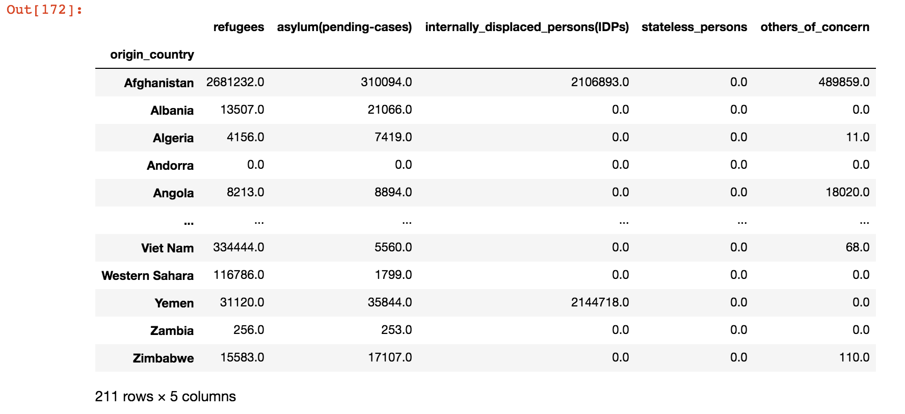
Displaced population as of 2018

Slide 9
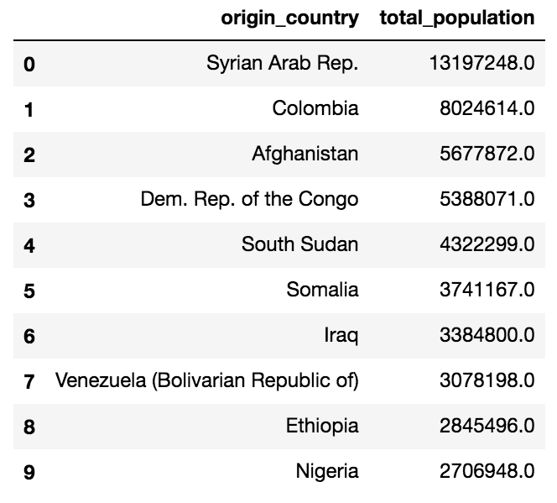
Top 10 Countries With Displaced People as of 2018

Slide 10
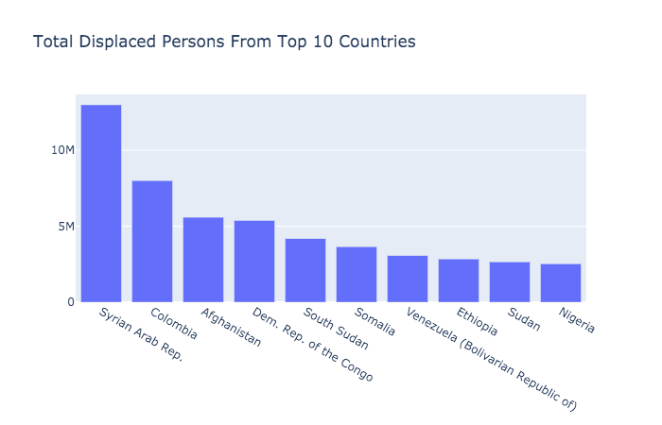

Slide 11
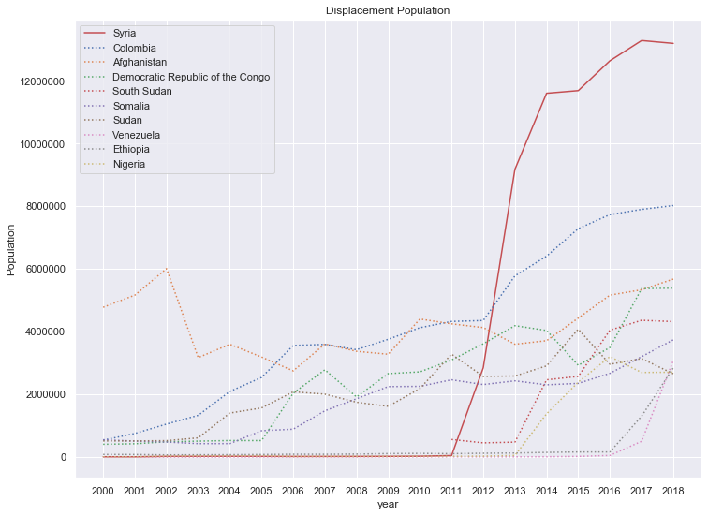

Slide 12
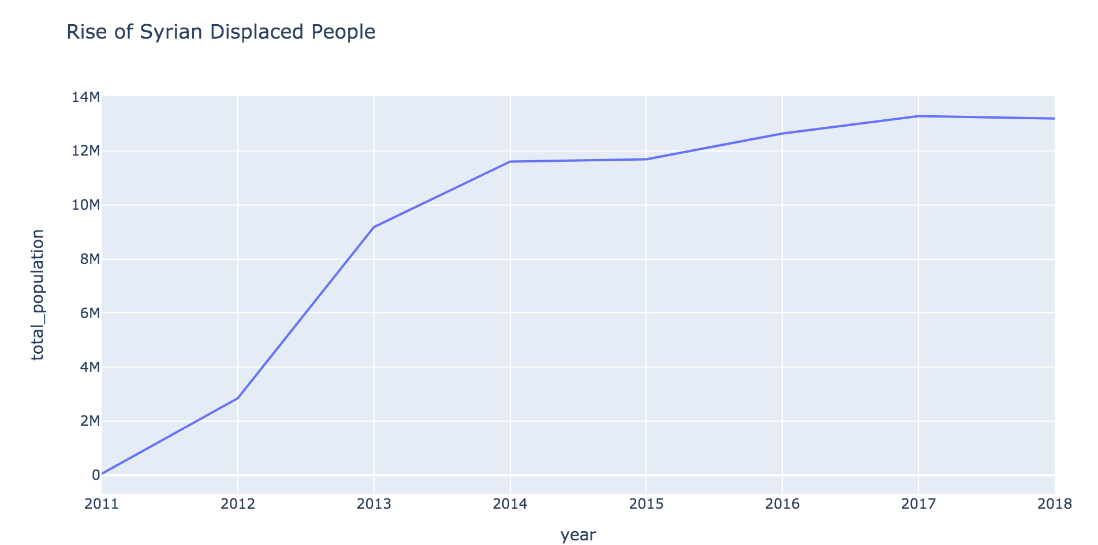

Slide 13
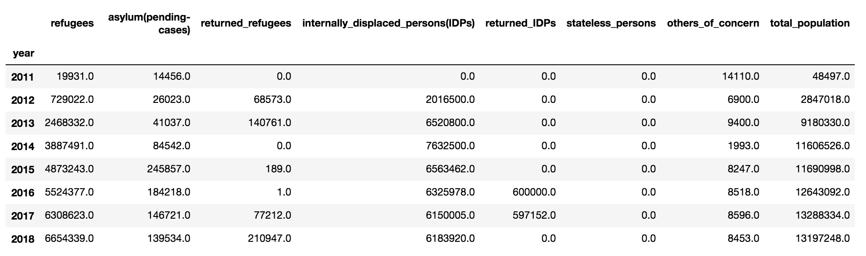
Observing Syrian Refugee Crisis
Civil War in Syria began in 2011

Slide 14
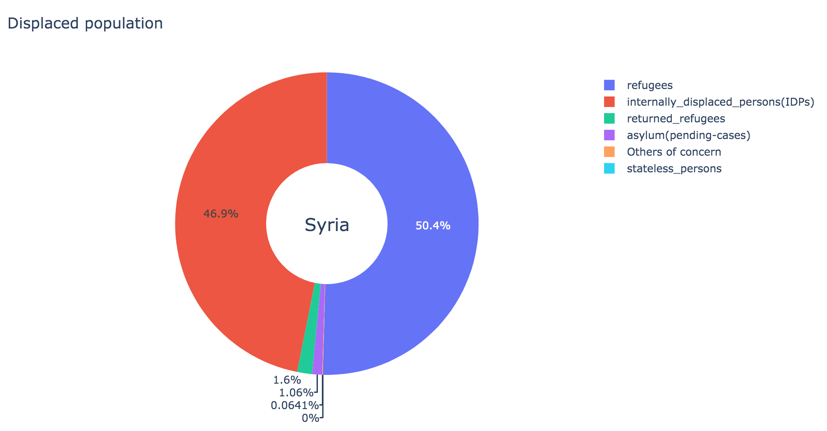

Slide 15
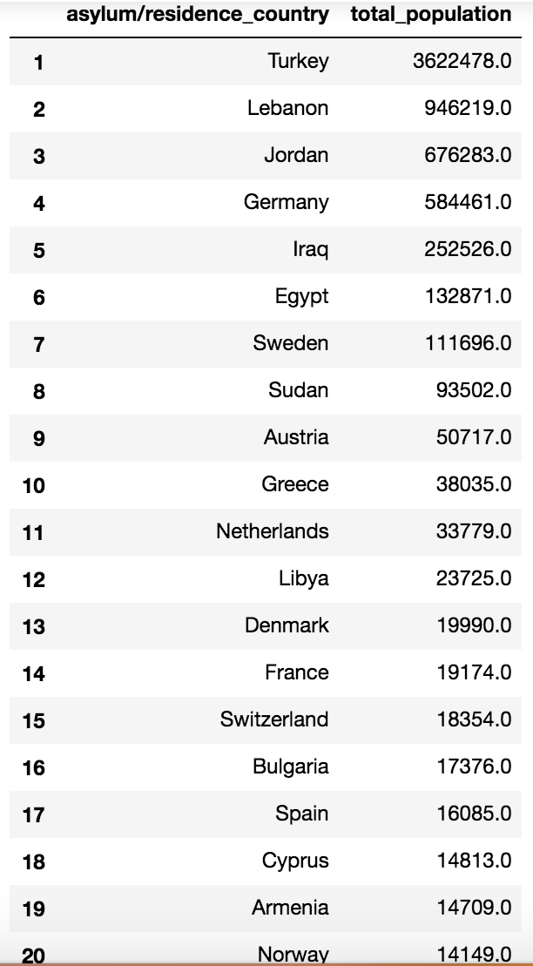
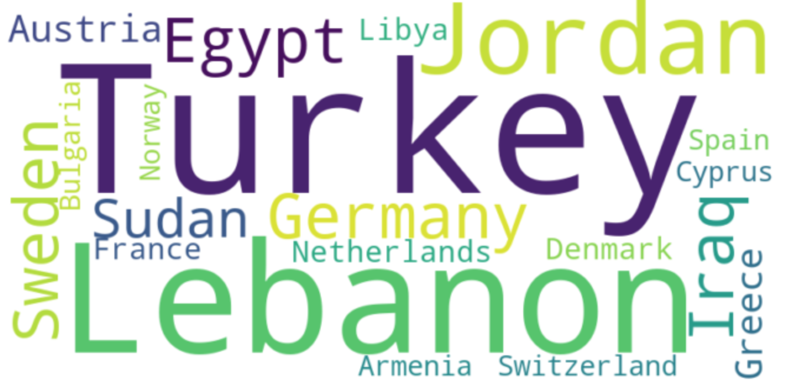
Syrian Refugees Welcome

Slide 16
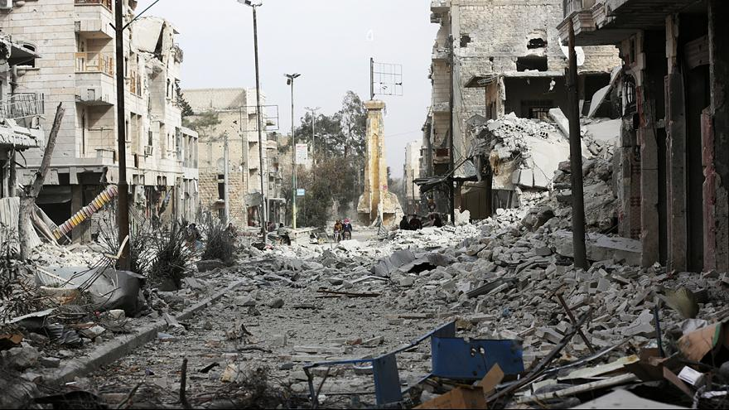
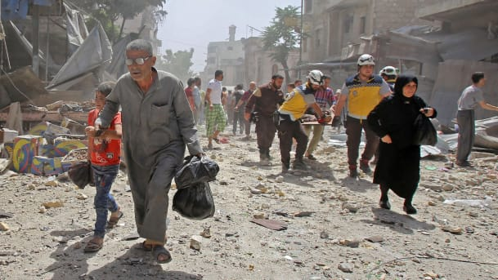
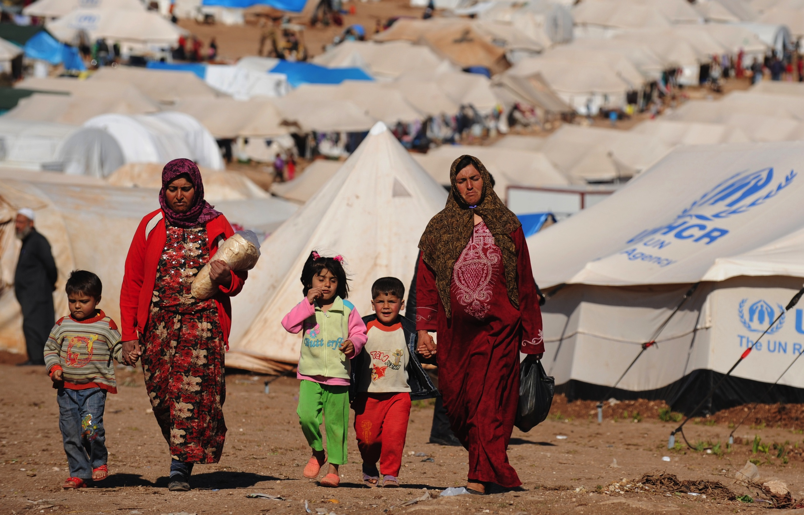
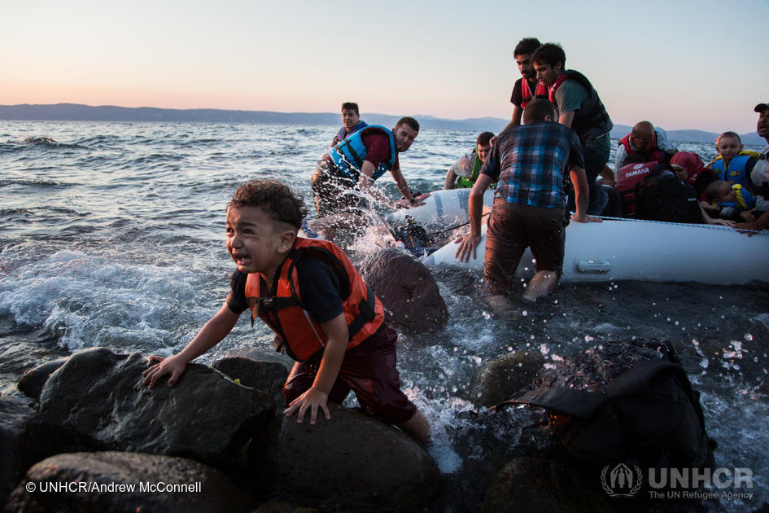

Slide 17
Questions?
UNHCR’s global trends in forced displacement:
https://www.youtube.com/watch?time_continue=300&v=ax5f9KsGfv8&feature=emb_logo

